Slide 1





ONLINE BLOOD BANK & DONOR MANAGEMENT SYSTEM
Team Members:
MK SREYA Guide: UMA MAHESHWARI R
RUKHAIAH
SASIKALA P
TEJASWI P
YASASWINI V

Slide 2
: Online blood bank and donor management system
OUTLINE
Abstract
Problem Statement
Aims, Objective & Proposed System/Solution
System Design/Architecture
System Development Approach (Technology Used)
Algorithm & Deployment
Conclusion
Future Scope
References
Video of the Project
Notes:
These are the list of chapters that we are going to cover in these foundation codes. Those are chapter one what are AI and ML? chapter 2 applied Python programming in AI, and chapter 3 is exploratory data analysis for ML.

Slide 3
Abstract
: Online blood bank and donor management system
The “Blood Donor Management System” is an associate work that brings voluntary blood donors and those in need of blood to an emergency. The donors as well as the seekers have to register themselves by providing their basic details in the web application . The main goal of the Blood Bank and Donor Management System project is to monitor Blood Bank data, Donor List, Manage Queries, Respond to the queries. It manages all the Blood Donors, Donor contact Details. The project is entirely administrative and therefore access is guaranteed only to the administrator. The project's aim is to develop an application system to minimize the manual work for Blood Bank, Donor, Blood Group management. It monitors all of the Blood Group information and Donor list

Slide 4
Problem Statement
: Online blood bank and donor management system
The major problem in old Blood banking systems was that, they don’t follow the actual needs of users . Traditional blood banking systems were developed by 1 or 2 perspective. Tracking the database was complicated when the details are maintained manually. There was shortage and sometimes unavailability of rare blood groups due to less modules i.e. patient and donors.

Slide 5
Aim and Objective
: Online blood bank and donor management system
Aim:
The main aim of this project is to help the people who needs blood in emergency and to associate some donors who are willing to donate their blood to needy people and save their lives. his system seeks to address the challenges faced by existing blood banking processes and contribute to the overall improvement of healthcare services through a streamlined and accessible blood donation management system.
Objectives:
Create a User-Friendly Platform.
Provides required info in no time and also Helps in quicker decision making.
Helps to motivate people for Blood Donation easily.
Educate and Raise Awareness.

Slide 6
Proposed Solution
: Online blood bank and donor management system
The proposed solution for a blood bank management system entails developing a comprehensive software platform with user-friendly interfaces, donor, Continuous Improvement and Support and communication systems, robust security features, reporting capabilities, scalability, and ongoing support. This integrated solution aims to streamline processes, enhance donor engagement, improve patient care, and ensure compliance with regulatory standards, ultimately facilitating timely access to safe blood products and saving lives.

Slide 7
System Architecture
: Online blood bank and donor management system
User Module:
User
Home
Become a Donor
About Us
Contact Us
Donor List
Search Donor

Slide 8
: Online blood bank and donor management system
Admin Module:
Admin
Login
Add & Delete donor’s data
Manage queries
Check Activities
Logout

Slide 9
Algorithm
: Online blood bank and donor management system
Donor Registration Algorithm:
Upon registration, the donor provides personal details including blood type, contact information, and location.
Store the donor's information in a database.
2. Search Algorithm:
User inputs the required blood type and location.
Search the database for donors matching the specified blood type and location.
Return a list of matching donors.
3. Request Algorithm:
User selects a donor from the list and requests their contact details.
The request is sent to the admin.
Admin checks if the selected donor has opted to reveal their details.
If the donor has agreed, the admin sends their contact details to the user.

Slide 10
Algorithm
: Online blood bank and donor management system
4. Notification Algorithm:
Notify the admin when a new donor registers.
Notify the admin when a user requests a donor's contact details.
5. Security Algorithm:
Implement secure data storage and transmission protocols to protect donor information.
Ensure that only authorized users (admin and registered donors) can access the system.
6.Location-based Matching Algorithm:
Implement a mechanism to prioritize donors based on proximity to the requester's location to facilitate quicker response times in emergencies.

Slide 11
Deployment Steps
: Online blood bank and donor management system
Set Up the Database:​ Create a MySQL database with a table named donors containing fields like name, number, email, blood group, gender, age and Address.​
Create Config.php:​ Create a PHP script (Config.php) responsible for establishing a connection to the MySQL database. Make sure to handle errors gracefully.​
Deploy PHP Script:​ Place the PHP script containing the provided code on your web server. Ensure it is accessible via the appropriate URL.​
Configure Server Environment:​ Ensure that your server environment supports PHP and MySQL. For that install Xampp server
5. Test the Application:​ Test the login functionality thoroughly to ensure it works as expected.​ Check for any security vulnerabilities, such as SQL injection or session fixation attacks.​
6. Monitor and Maintain:​ Regularly monitor your application for errors and security vulnerabilities.​ Keep your server software, including PHP and MySQL, Xampp server up to date with the latest patches and update
​

Slide 12
Technology Used
: Online blood bank and donor management system
Operating System: Windows​
Front-End: HTML, CSS, JavaScript​
Back-End: PHP
Data-Base: MySQL​
Server: Xampp Server

Slide 13
Conclusion
: Online blood bank and donor management system
In conclusion, implementing a blood bank management system offers numerous benefits, including efficient blood donation management, improved donor and recipient tracking, enhanced communication between stakeholders, and ultimately, the potential to save lives by ensuring timely access to blood products. By integrating user-friendly interfaces, robust modules for donor ,efficient communication systems, and stringent security measures, the system aims to enhance operational efficiency, improve donor engagement, and ensure timely access to safe blood products. Through streamlined processes and better utilization of resources, blood banks can fulfill their vital role in healthcare more effectively, contributing to better patient outcomes and overall community health.

Slide 14
Future Scope
: Online blood bank and donor management system
Integration with IoT Devices for Real-Time Monitoring:
Incorporating IoT sensors for real-time monitoring of donor health metrics during donations and tracking blood product conditions throughout the supply chain.
Blockchain Technology for Transparency:
Implementing blockchain technology to ensure transparency, traceability, and security in donation and transfusion processes, enhancing trust among stakeholders.
Mobile Units for Outreach:
Developing mobile blood donation units equipped with the system to facilitate outreach programs and community-based events, increasing donation accessibility and awareness.
Global Collaboration for Data Sharing:
Establishing collaborative networks with blood banks and healthcare organizations worldwide to facilitate data sharing, standardize protocols, and address challenges on a global scale.

Slide 15
: Online blood bank and donor management system
References
https://www.docsmart.in/blog/online-blood-donation-and-management-system-in-india--52cb
https://www.360iresearch.com/library/blog/blood-bank-management-software
Notes:
Reference
These are the references for this session.
15

Slide 16
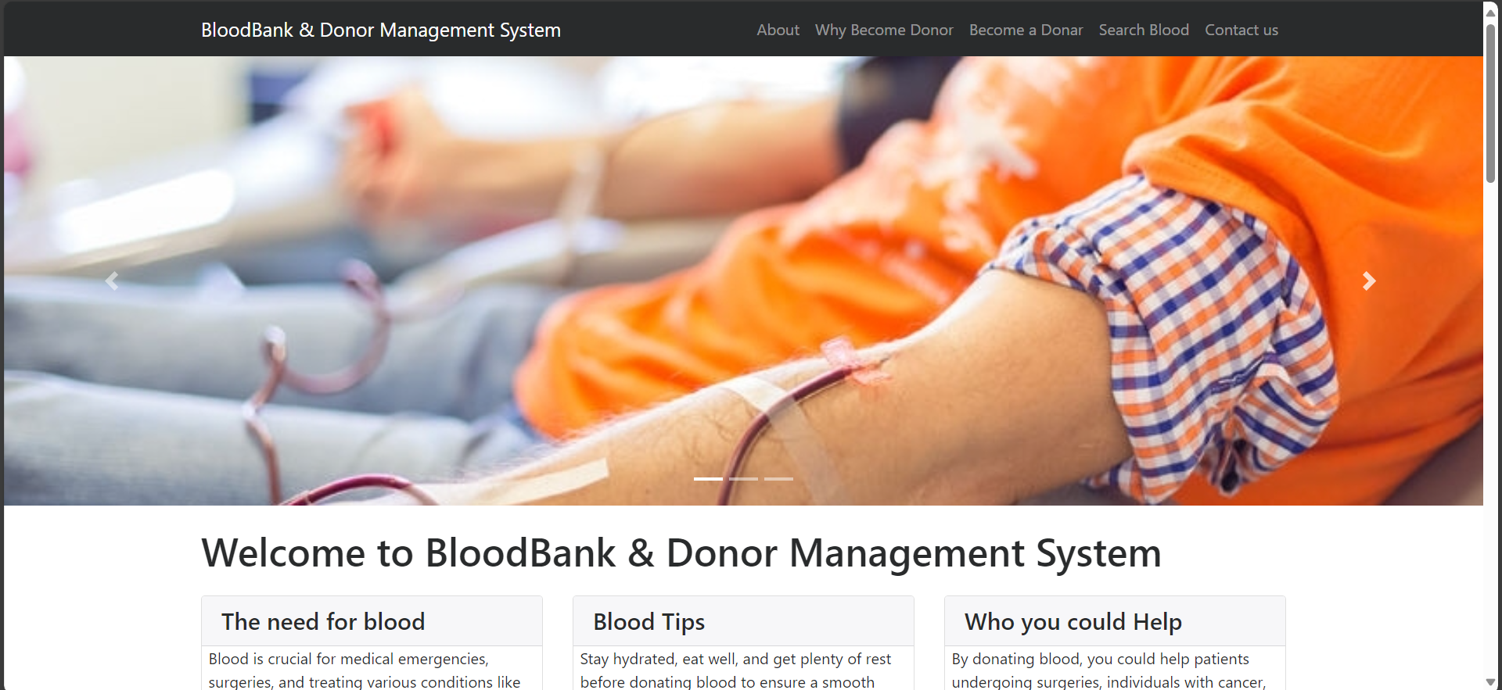
Frontend part
: Online blood bank and donor management system
Home Page:

Slide 17
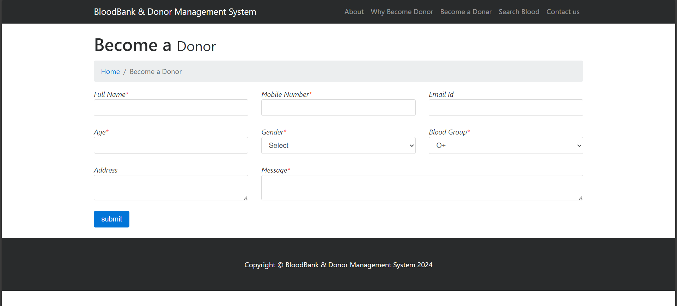
Frontend part
: Online blood bank and donor management system
Register Page:

Slide 18
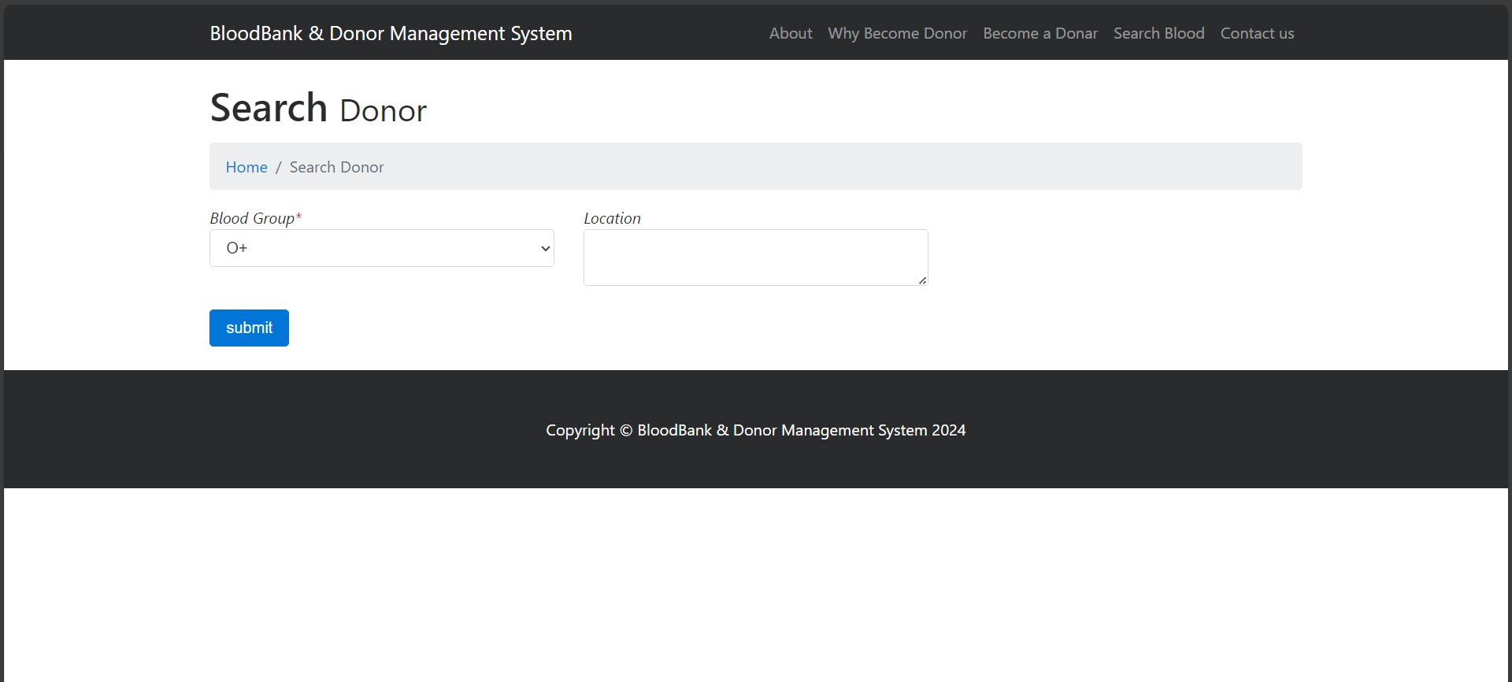
Frontend part
: Online blood bank and donor management system
Search For Blood Page:

Slide 19
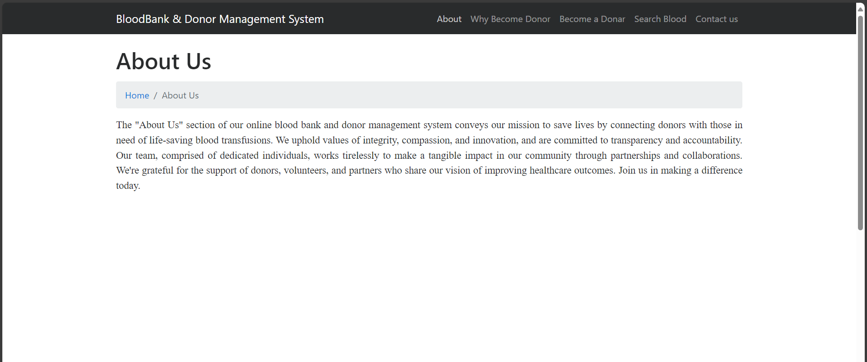
Frontend part
: Online blood bank and donor management system
About Us Page:

Slide 20
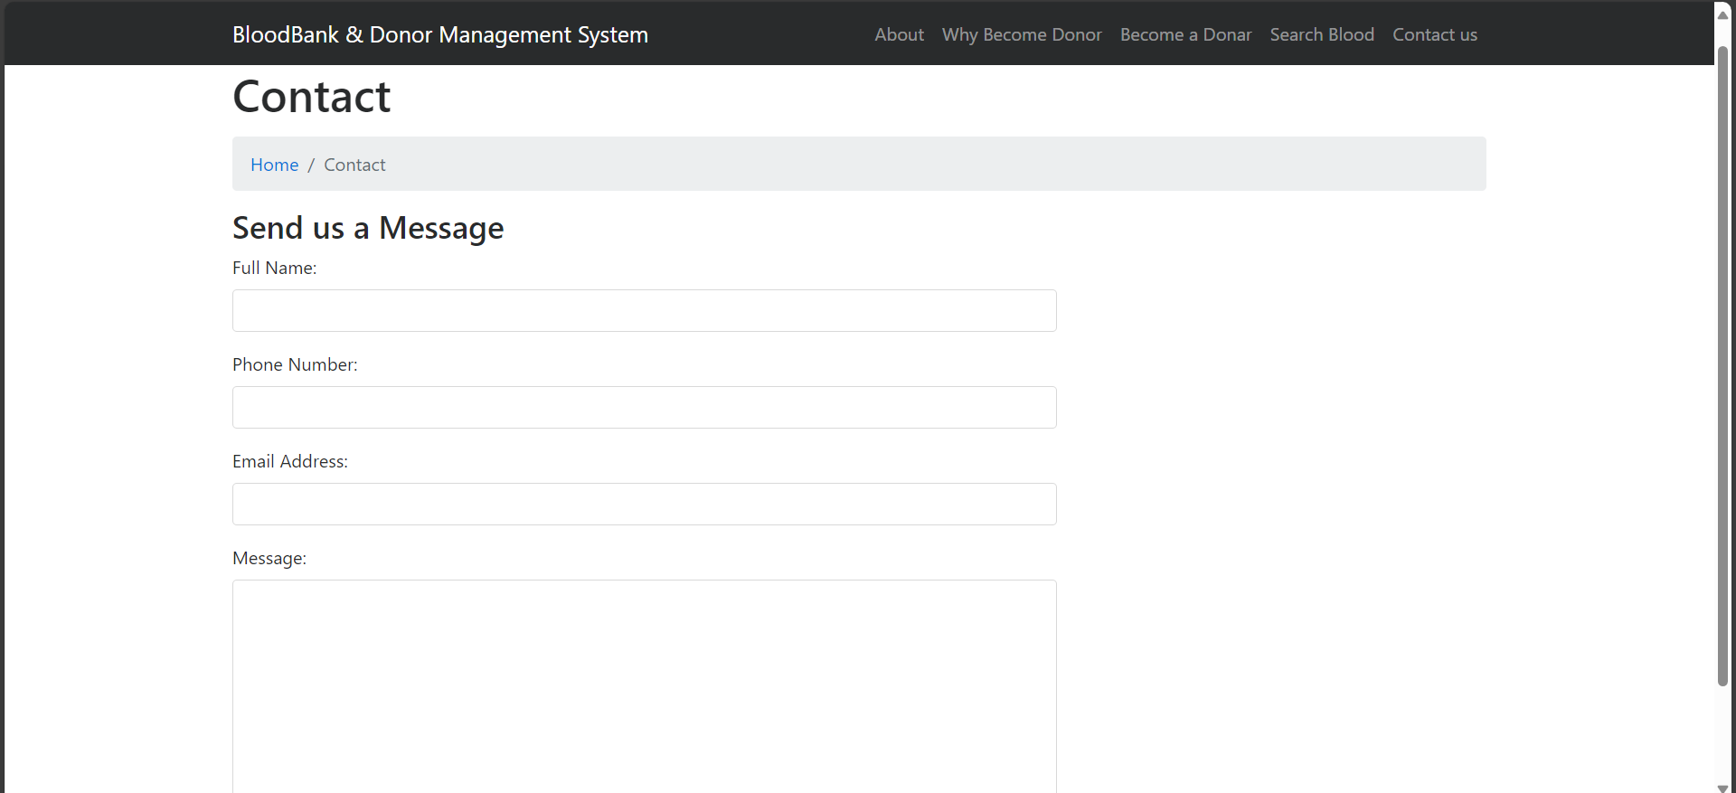
Frontend part
: Online blood bank and donor management system
Contact Us Page:

Slide 21
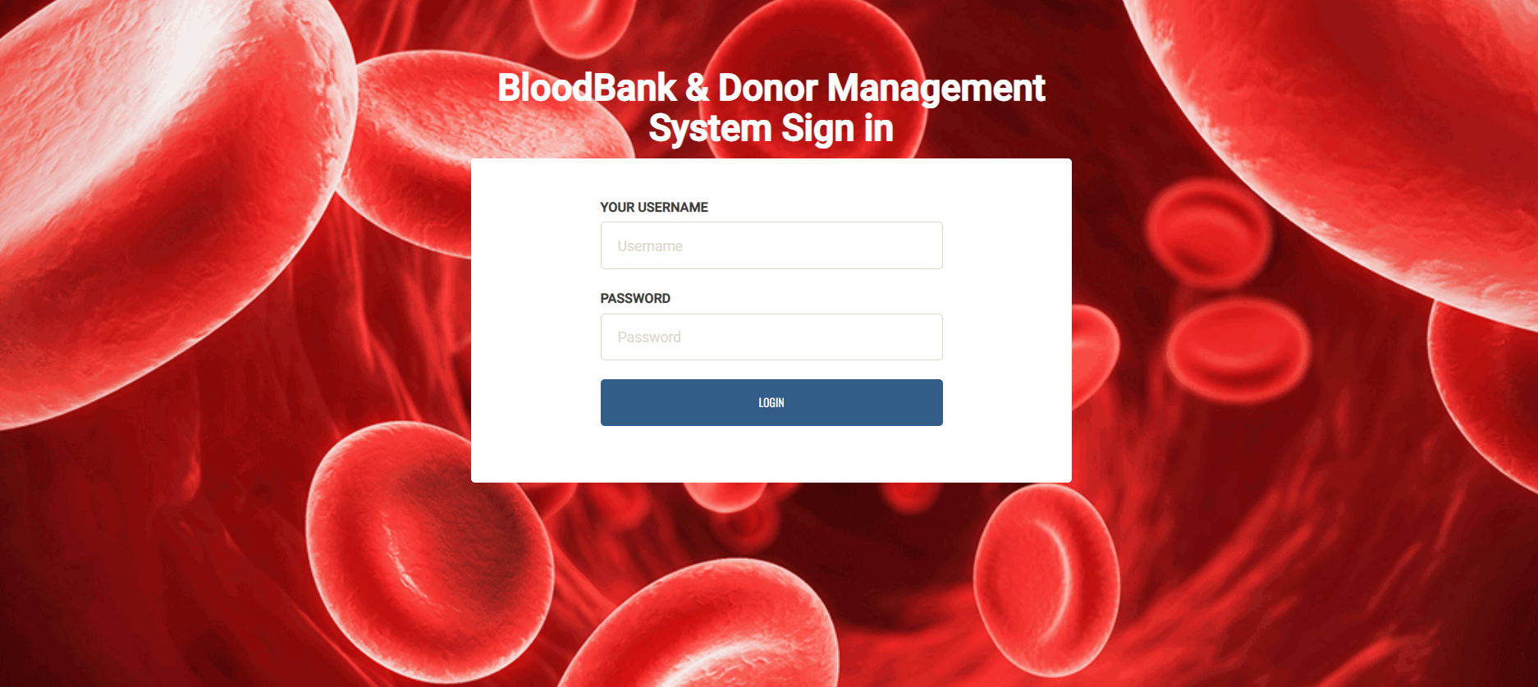
Frontend part (Admin Side)
: Online blood bank and donor management system
Login Page:

Slide 22
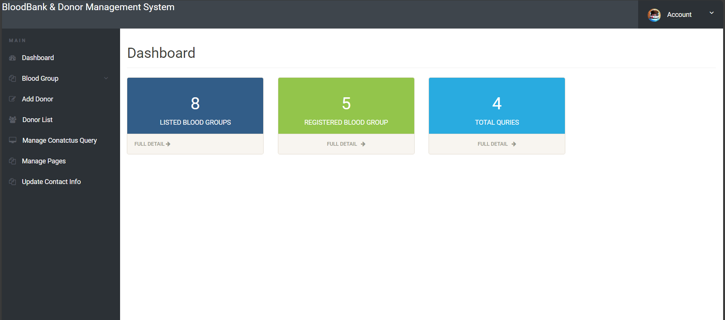
Frontend part (Admin Side)
: Online blood bank and donor management system
Dashboard Page:

Slide 23
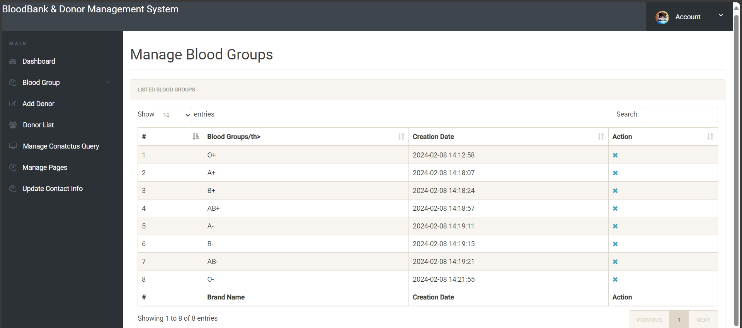
Frontend part (Admin Side)
: Online blood bank and donor management system
Manage Blood Groups Page:

Slide 24
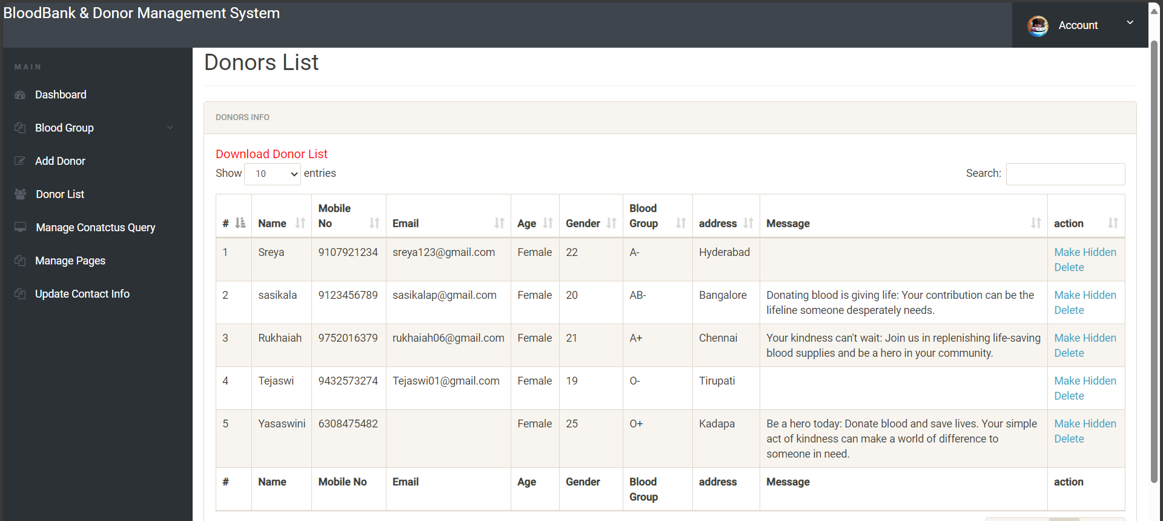
Frontend part (Admin Side)
: Online blood bank and donor management system
Donors List Page:

Slide 25
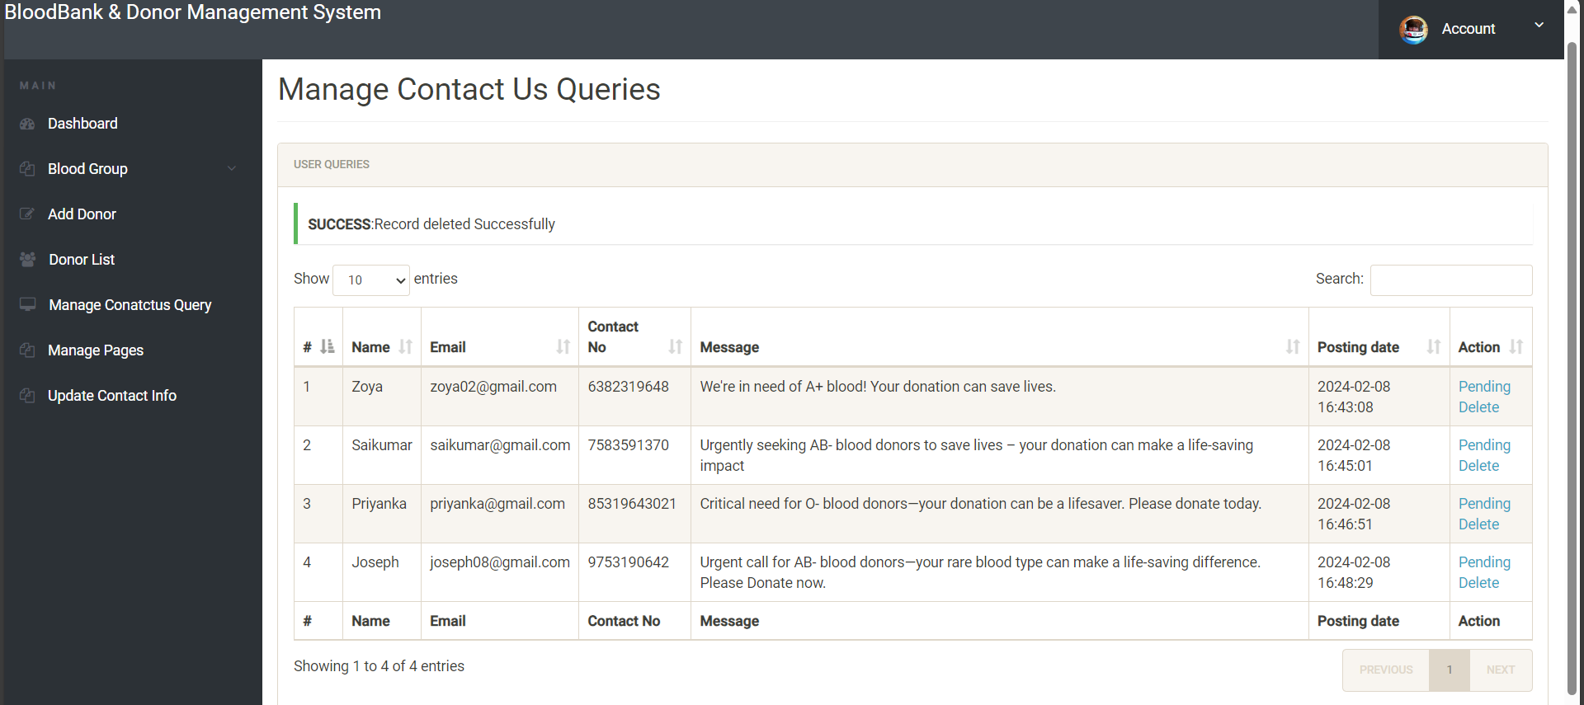
Frontend part (Admin Side)
: Online blood bank and donor management system
Manage Query Page:

Slide 26
: Online blood bank and donor management system
Thank you!
Notes:
thank you very much for joining this PPT, keep learning.
26

